Slide 1
Automating Client Selection

Slide 2
Step to Achieve
Familiarize myself with the current systems
Migrate data location from Airtables to Google Sheets
Recreate model using new data and by referencing the data directly from Google Sheets
Create a method for the ”Qscore” to be automatically generated on an existing Google Sheet, creating a fully autonomous client selection process
So… how does this look?

Slide 3
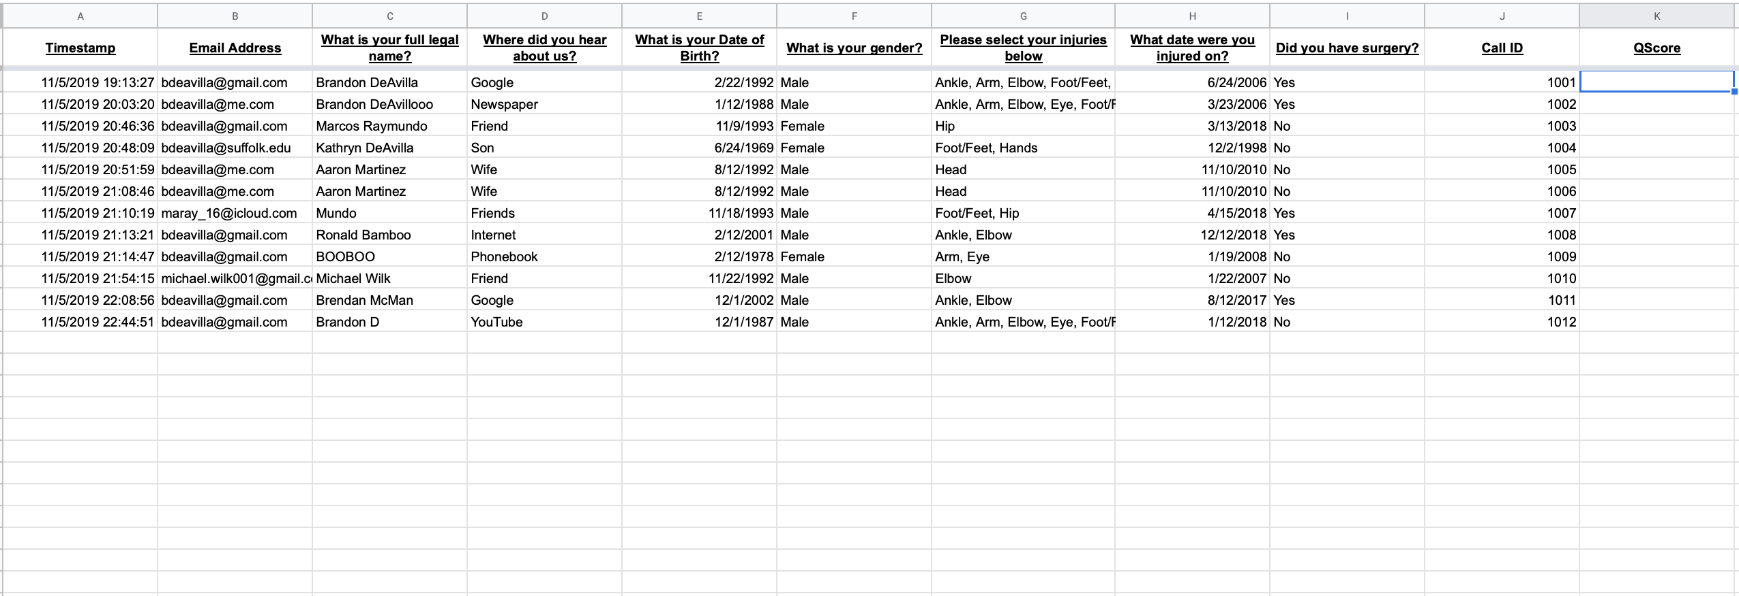
Step 1

Slide 4
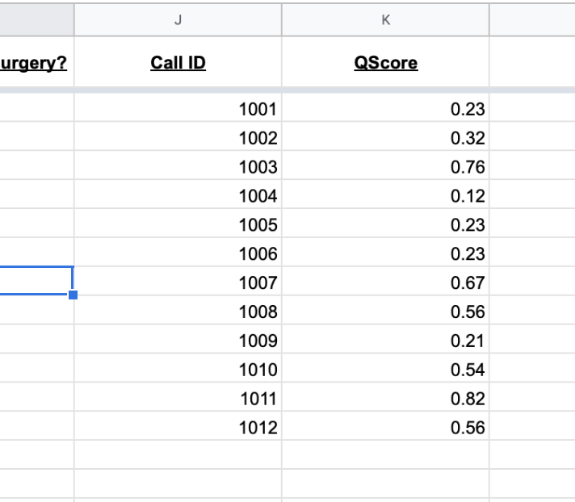
Step 2
The displayed Qscore will be run through a background model, retrieve the Qscore and then post it into its respective row

Slide 5
Potential Challenges
Properly placing Qscores into correct rows on Google Sheets
Sending only the rows without Qscores to the model to avoid having to clean all of the data each time data is run
Methods of automating a Python script within a Google Sheet

Slide 6
Questions?

